Slide 1

MongoDB
And NoSQL Databases

Slide 2
MongoDB Overview
From “humongous”
Document-oriented database, not relational
Schema free
Manages hierarchical collection of BSON (bee-son) documents
Written in C++
Has an official driver for C# with support from 10gen
Scalable with high-performance (scales horizontally)
Designed to address today’s workloads
BASE rather than ACID compliant
Replication
Part of the “NoSQL” class of DBMS
Website with list of all features - http://www.mongodb.org/

Slide 3
What is NoSQL?
Class of DBMS that differ from relational model
Do not expose the standard SQL interface
May not require fixed table schemas, usually avoid join operations, and typically scale horizontally.
Term coined by Carlo Strozzi in 1998 to name his lightweight, open-source relational database that did not expose the standard SQL interface.
However as Strozzi said, because the current NoSQL movement is departing “from the relational model altogether; it should therefore have been called more appropriately 'NoREL', or something to that effect.“
http://nosql-database.org/ for examples.

Slide 4
Why are these interesting?
New requirements are arising in environments where we have higher volumes of data with high operation rates, agile development and cloud computing. This reflects the growing interactivity of applications which are becoming more networked and social, driving more requests to the database where high-performance DBMS such as MongoDB become favorable.
Not requiring a schema or migration scripts before you add data makes it fit well with agile development approaches. Each time you complete new features, the schema of your database often needs to change. If the database is large, this can mean a slow process.

Slide 5
ACID
Relational databases make the ACID promise:
Atomicity - a transaction is all or nothing
Consistency - only valid data is written to the database
Isolation - pretend all transactions are happening serially and the data is correct
Durability - what you write is what you get
The problem is ACID can give you too much, it trips you up when you are trying to scale a system across multiple nodes.
Down time is unacceptable so your system needs to be reliable. Reliability requires multiple nodes to handle machine failures.
To make scalable systems that can handle lots and lots of reads and writes you need many more nodes.
Once you try to scale ACID across many machines you hit problems with network failures and delays. The algorithms don't work in a distributed environment at any acceptable speed.
http://highscalability.com/drop-acid-and-think-about-data

Slide 6
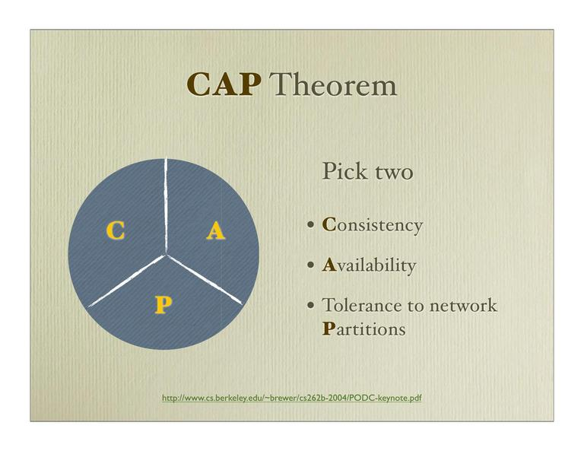
CAP
If you can't have all of the ACID guarantees it turns out you can have two of the following three characteristics:
Consistency - your data is correct all the time. What you write is what you read.
Availability - you can read and write and write your data all the time
Partition Tolerance - if one or more nodes fails the system still works and becomes consistent when the system comes on-line.
In distributed systems, network partitioning is inevitable and must be tolerated, so essential CAP means that we cannot have both consistency and 100% availability.
“If the network is broken, your database won’t work.”
However, we do get to pick the definition of “won’t work”. It can either mean down (unavailable) or inconsistent (stale data).
http://www.julianbrowne.com/article/viewer/brewers-cap-theorem

Slide 7
BASE
The types of large systems based on CAP aren't ACID, they are BASE (ha ha)
Basically Available - system seems to work all the time
Soft State - it doesn't have to be consistent all the time
Eventually Consistent - becomes consistent at some later time
Many companies building big applications build them on CAP and BASE: Google, Yahoo, Facebook, Amazon, eBay, etc.
Amazon popularized the concept of “Eventual Consistency”. Their definition is:
the storage system guarantees that if no new updates are made to the object, eventually all accesses will return the last updated value.
A few examples of eventually consistent systems:
Asynchronous master/slave replication on an RDBMS or MongoDB
DNS
memcached in front of mysql, caching reads
For more depth and different configuration examples: http://blog.mongodb.org/post/498145601/on-distributed-consistency-part-2-some-eventual

Slide 8
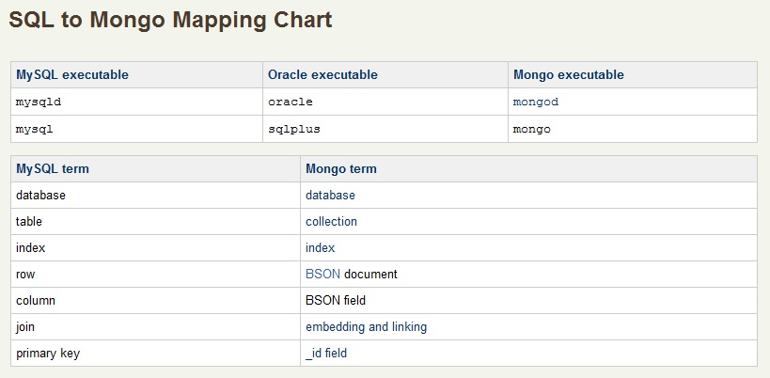
To get an idea..

Slide 9
BSON
Stands for Binary JSON
Is a binary encoded serialisation of JSON-like documents.
Like JSON, BSON supports the embedding of documents and arrays within other documents and arrays. BSON also contains extensions that allow representation of data types that are not part of the JSON spec. For example, BSON has a Date type and a BinData type.
The driver performs translation from the language’s “object” (ordered associative array) data representation to BSON, and back:
C#: new BsonDocument("x", 1) Javascript: {x: 1}

Slide 10
Querying in MongoDB
The query expression in MongoDB (and other things, such as index key patterns) is represented like JSON objects (BSON). However, the actual verb (e.g. "find") is done in one's regular programming language.
Usually we think of query object as the equivalent of a SQL "WHERE" clause:
C#: db[“users"].Find(Query. EQ(“x”, 3)).SetSortOrder(SortBy.Ascending(“y"));
// select * from users where x=3 order by x asc;
Javascript: db.users.find( {x : 3} ).sort( {y : 1} );
More on ways of creating queries:
http://www.mongodb.org/display/DOCS/CSharp+Driver+Tutorial#CSharpDriverTutorial-FindandFindAsmethods
Note: In MongoDB, just like in an RDBMS, creating appropriate indexes for queries is quite important for performance.
For a quick tutorial using the shell visit http://try.mongodb.org/

Slide 11
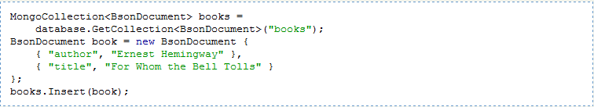
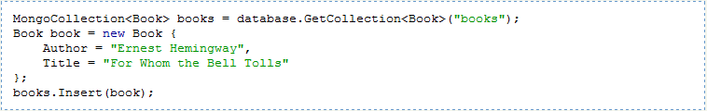
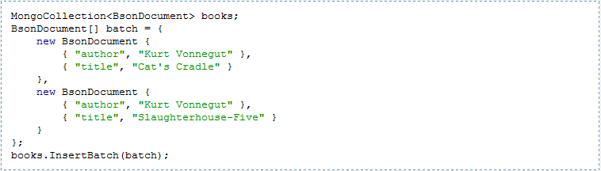
To insert a document in the collection create an object representing the document and call Insert. The object can be an instance of BsonDocument or of any class that can be successfully serialized as a BSON document. For example:
If you have a class called Book the code might look like:
You can insert more than one document at a time using the InsertBatch method. For example:

Slide 12
A Many to Many Association
In a relational DBMS use an intersection table and joins
In MongoDB use either embedding or linking
BsonDocument user = new BsonDocument {
{ "name", "John" },
{ "roles", new BsonArray{“Admin”, “User”, “Engineer”}}
};
users.Insert(user);
//To get all Engineers
users.Find(Query.EQ(“roles”,”Engineer”));

Slide 13
Embedding is the nesting of objects and arrays inside a BSON document. Links are references between documents.
There are no joins in MongoDB – distributed joins would be difficult on a 1,000 server cluster. Embedding is a bit like "prejoined" data. Operations within a document are easy for the server to handle; these operations can be fairly rich. Links in contrast must be processed client-side by the application; the application does this by issuing a follow-up query.
Generally, for "contains" relationships between entities, embedding should be chosen. Use linking when not using linking would result in duplication of data.
More detail on referencing:
http://www.mongodb.org/display/DOCS/Database+References

Slide 14
Replication through Replica Sets
Replica sets are a form of asynchronous master/slave replication, adding automatic failover and automatic recovery of member nodes.
A replica set consists of two or more nodes that are copies of each other. (i.e.: replicas)
The replica set automatically elects a primary (master). No one member is intrinsically primary; that is, this is a share-nothing design.
Drivers (and mongos) can automatically detect when a replica set primary changes and will begin sending writes to the new primary. (Also works with sharding)
Replica sets have several common uses (detail in next slide):
Data Redundancy
Automated Failover / High Availability
Distributing read load
Simplify maintenance (compared to "normal" master-slave)
Disaster recovery
http://www.mongodb.org/display/DOCS/Replica+Sets

Slide 15
Why Replica Sets
Data Redundancy
Replica sets provide an automated method for storing multiple copies of your data.
Supported drivers allow for the control of "write concerns". This allows for writes to be confirmed by multiple nodes before returning a success message to the client.
Automated Failover
Replica sets will coordinate to have a single primary in a given set.
Supported drivers will recognize the change of a primary within a replica set.
In most cases, this means that the failure of a primary can be handled by the client without any configuration changes.
A correctly configured replica set basically provides a “hot backup”. Recovering from backups is typically very time consuming and can result in data loss. Having an active replica set is generally much faster than working with backups.
Read Scaling
By default, the primary node of a replica set is accessed for all reads and writes.
Most drivers provide a slaveOkay method for identifying that a specific operation can be run on a secondary node. When using slaveOkay, a system can share the read load amongst several nodes.
Maintenance
When performing tasks such as upgrades, backups and compaction, it is typically required to remove a node from service.
Replica sets allow for these maintenance tasks to be performed while operating a production system. As long as the production system can withstand the removal of a single node, then it’s possible to perform a “rolling” upgrade on such things.
Disaster Recovery
Replica sets allows for a “delayed secondary” node.
This node can provide a window for recovering from disastrous events such as:
bad deployments
dropped tables and collections

Slide 16
Horizontal Scalability
Rather than buying bigger servers, MongoDB scales by adding additional servers - improvements come in the form of more processors and cores rather than faster processors from packing more CPUs and ram into a server (vertical scaling).
MongoDB easily supports high transaction rate applications because as more servers are added, transactions are distributed across the larger cluster of nodes, which linearly increases database capacity. With this model additional capacity can be added without reaching any limits.
MongoDB achieves this through auto-sharding.

Slide 17
Sharding
For applications that outgrow the resources of a single database server, MongoDB can convert to a sharded cluster, automatically managing failover and balancing of nodes, with few or no changes to the original application code.
Each shard consists of one or more servers and stores data using mongod processes (mongod being the core MongoDB database process). In a production situation, each shard will consist of multiple replicated servers per shard to ensure availability and automated failover. The set of servers/mongod process within the shard comprise a replica set.
Sharding offers:
Automatic balancing for changes in load and data distribution
Easy addition of new machines
Scaling out to one thousand nodes
No single points of failure
Automatic failover
http://www.mongodb.org/display/DOCS/Sharding+Introduction

Slide 18
Large MongoDB Deployment example
1. One or more shards, each shard holds a portion of the total data (managed automatically). Reads and writes are automatically routed to the appropriate shard(s). Each shard is backed by a replica set – which just holds the data for that shard.
A replica set is one or more servers, each holding copies of the same data. At any given time one is primary and the rest are secondaries. If the primary goes down one of the secondaries takes over automatically as primary. All writes and consistent reads go to the primary, and all eventually consistent reads are distributed amongst all the secondaries.
2. Multiple config servers, each one holds a copy of the meta data indicating which data lives on which shard.
3. One or more routers, each one acts as a server for one or more clients. Clients issue queries/updates to a router and the router routes them to the appropriate shard while consulting the config servers.
4. One or more clients, each one is (part of) the user's application and issues commands to a router via the mongo client library (driver) for its language.
mongod is the server program (data or config). mongos is the router program.

Slide 19
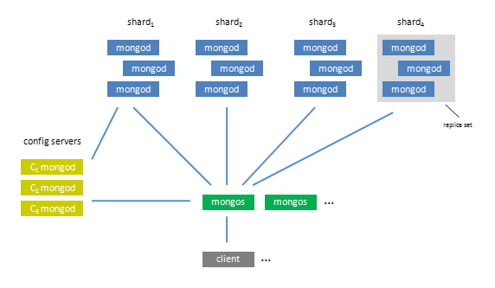

Slide 20
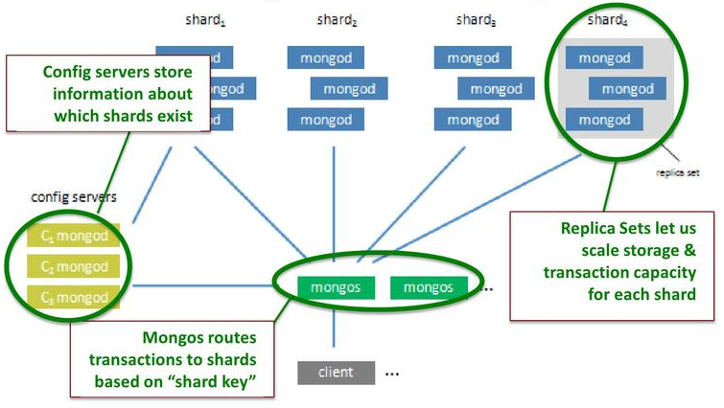

Slide 21
Companies using MongoDB
Just a few here..
Foursquare – moved over from PostgreSQL
Craigslist – moved over from a large MySQL cluster. Schema changes were taking forever and it wasn’t really relational information. They wanted to be able to add new machines without downtime (which sharding provides) and route around dead machines without clients failing (which replica sets provide).
Sourcefourge – moved over from MySQL. MongoDB is used for back-end storage on the SourceForge front pages, project pages, and download pages for all projects.
The New York Times - using it in a form-building application for photo submissions. Mongo's dynamic schema gives producers the ability to define any combination of custom form fields.
Full list at http://www.mongodb.org/display/DOCS/Production+Deployments

Slide 22
Further Resources
Article: Going NoSQL with MongoDB
C# Driver Tutorial
GUI Tool like Management Studio - http://www.mongovue.com/
10gen White Paper
http://www.mongodb.com/
Wikipedia pages for MongoDB, NoSQL etc.
Google Groups mongodb-user and mongodb-csharp

